Slide 1

AIRPORT NETWORK FLIGHT SCHEDULER
AKASH 1710991063
AKHIL 1710991064
AKRITI 1710991065
AKSHAT 1710991066
AKSHAY 1710991067

Slide 2
TABLE CONTENT
1. Objective and Scope of project
2. Requirement analysis and gathering
3. Designing
4. Designing
5. Coding Output
6. Testing
7. Maintenance
8. Deployment

Slide 3
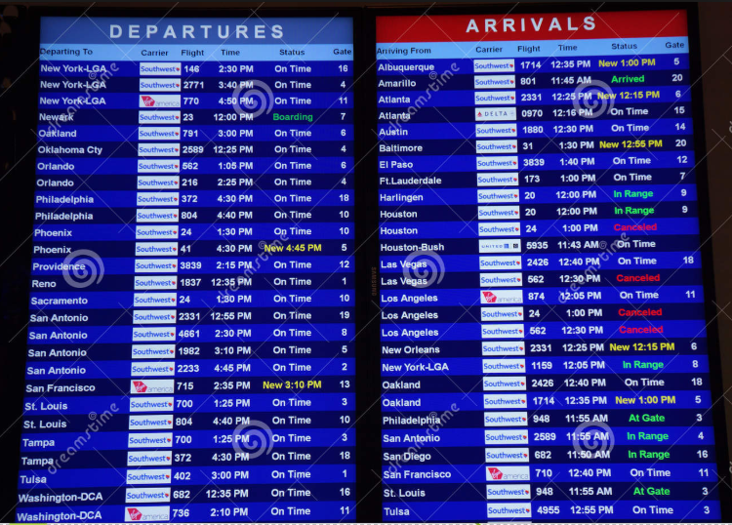
OBJECTIVE OF PROJECT
Users will get all information about
flights timing and is it on on-time
or not.
Traveler’s Family can see that if the
flight is on time or not.
All ATC (Air Traffic Control) Centers
will know the timing of take-off and
landing of the flight.

Slide 4
REQUIREMENT ANALYSIS AND GATHERING
Language and Tools
Java language is used for coding.
Used tool net beans in java for fulfilling the requirements.
SQL database system is used for storing all the data.

Slide 5
j
FUNCTIONAL REQUIRMENTS
Store takeoff and landing flights data with date and time.
Store data related to flights e.g. passengers traveled in a flight, flight registration number etc.
Store route of flights and destination.
Automatically warning is issued when weather is not suitable.
Automatic message is created if route and time is same for two flights.
Fuel consumption for every flight is stored.
Data stored separately for international and domestic flights and passengers.

Slide 6
l
Non Functional Requirements
Privacy requirement
Availability requirement
Capacity requirement
Backup and recovery requirement
Performance requirement
Security requirement
Reliability requirement
Maintainability

Slide 7
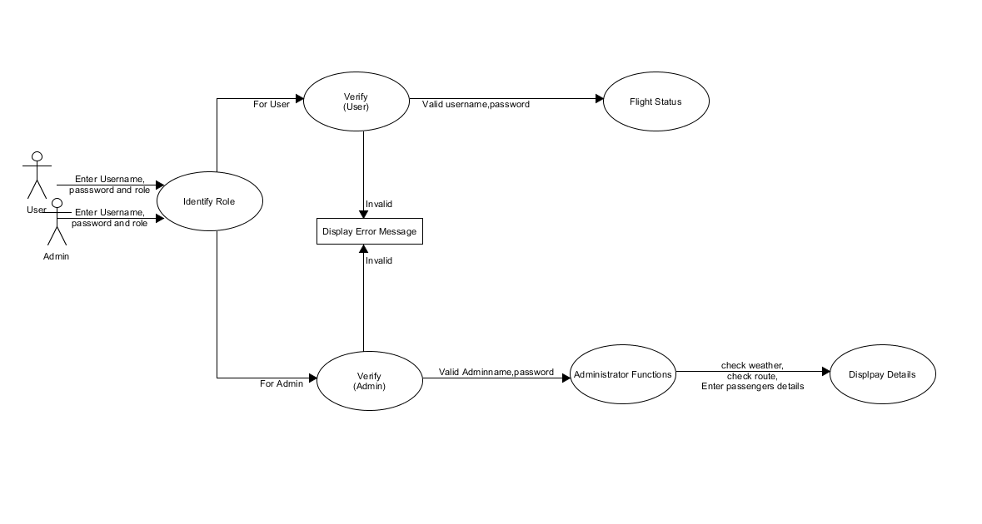
DESIGNING : DFD

Slide 8
DESIGNING : OTHER MODELS

Slide 9
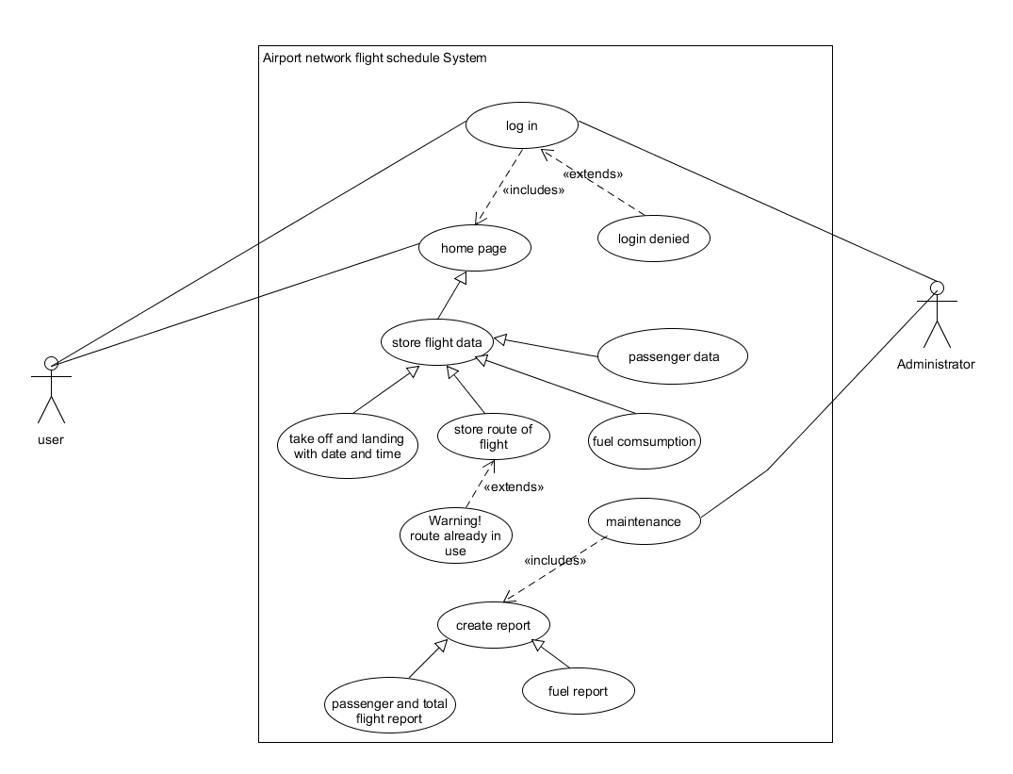
USE CASE

Slide 10
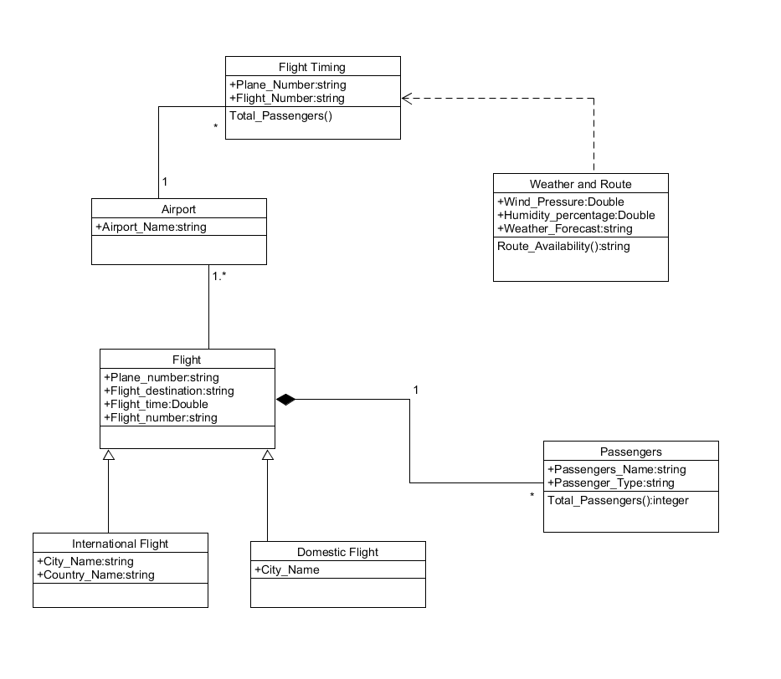
CLASS DIAGRAM

Slide 11
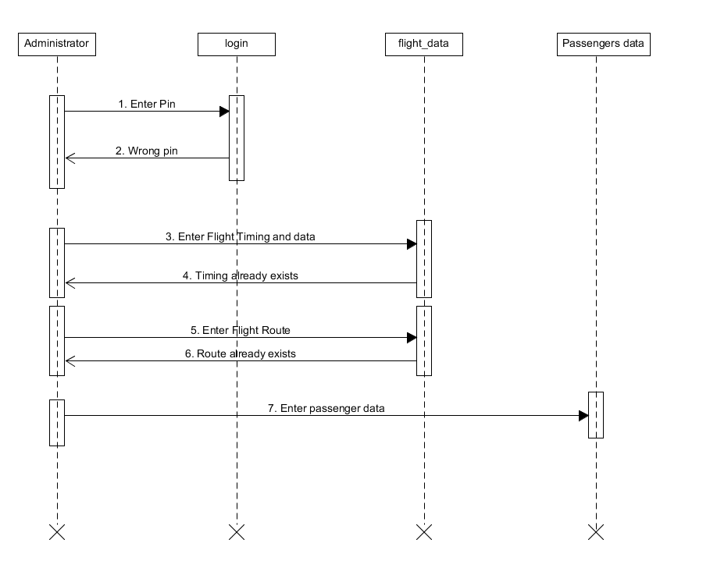
SEQUENCE DIAGRAM

Slide 12
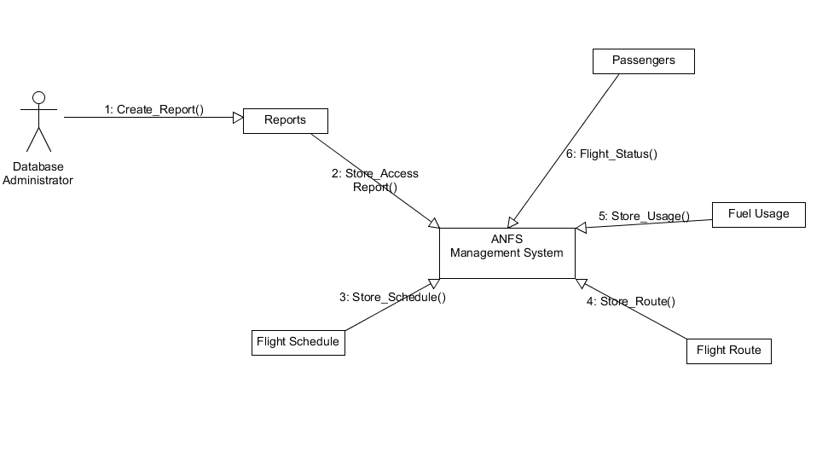
COLLABORATION DIAGRAM

Slide 13
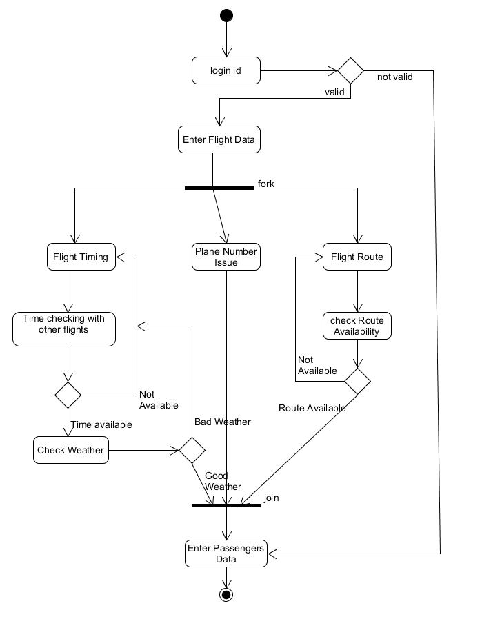
ACTIVITY DIAGRAM

Slide 14
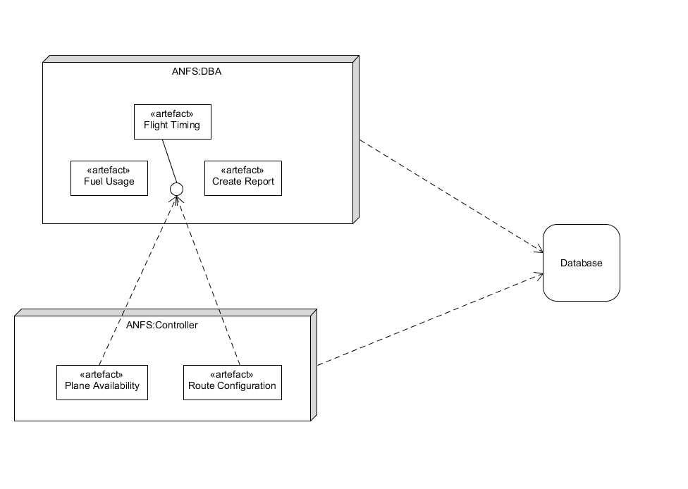
DEPLOYMENT DIAGRAM

Slide 15

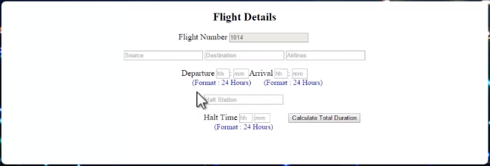
CODING OUTPUT:

Slide 16
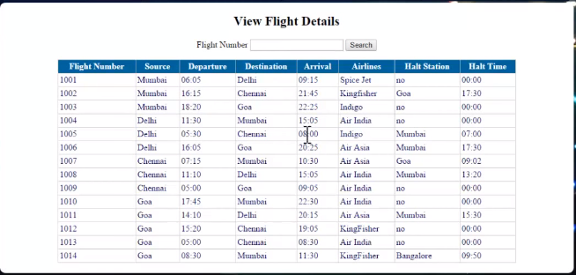

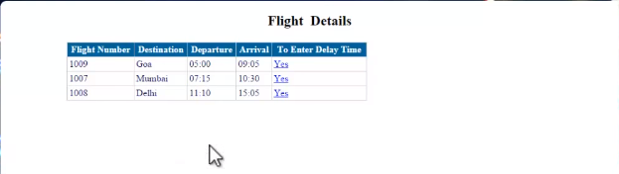

Slide 17
TESTING
Approach:
1. Functional Specifications are thoroughly reviewed for correctness, coverage, and completeness.
2. Study of design specifications and review for requirement coverage.
3. Preparation of database scripts for testing.
4. Review the design of system components.
Scope:
1. The system has different types of applications that were used for input, manipulation, and output of data.
2. The system will be tested for the useability, functionality, reliability, and performance of the application as a whole and in parts.

Slide 18
DEPLOYMENT
1. In this system, there is an admin module which enters the detail about flights and its timing and these details pass through internet server and are fetched by the system on other airports. This system is deployed on the admin side in the control room of the airport.
2. The second system will get all the information about all flights but will automatically select the data that refers to a particular airport and shows that information on the screen. This second System is installed on various locations on the airport for viewers to view the information.

Slide 19
MAINTENANCE
Maintenance of the system should be done by the administrator and airport authority.
The database should be properly maintained and faults should be corrected. All information regarding flight should be properly recorded.
The applications responsible for input, manipulation, and output of data should be properly checked.

Slide 20
CONCLUSION
To conclude:-
Airport Network Flight Scheduler is the system in which all the information regarding flight status like arrival time, departure time, destination, and delay time is uploaded by an administrator. This information can be easily fetched by a user and can check about flights timing is it on on-time or not.

Slide 21


